Slide 1
11ay QD model

Slide 2
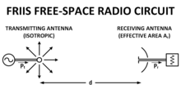
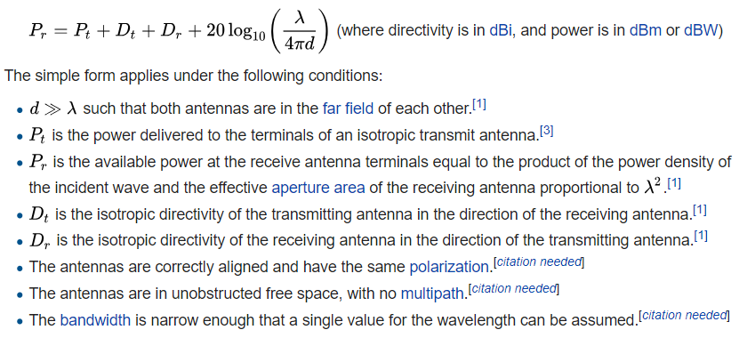
Friis transmission model

Slide 3
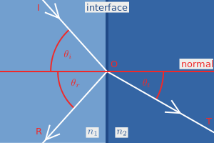
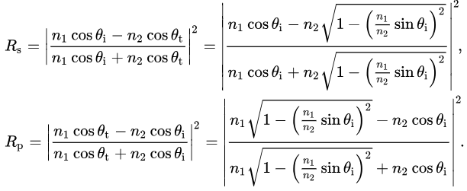
Fresnel equation
coordinate system frequently used relates to the plane of incidence.
This is the plane made by the incoming propagation direction and the vector perpendicular to the plane of an interface, in other words, the plane in which the ray travels before and after reflection or refraction. The component of the electric field parallel to this plane is termed p-like (parallel) and the component perpendicular to this plane is termed s-like (from senkrecht, German for perpendicular).

Slide 4
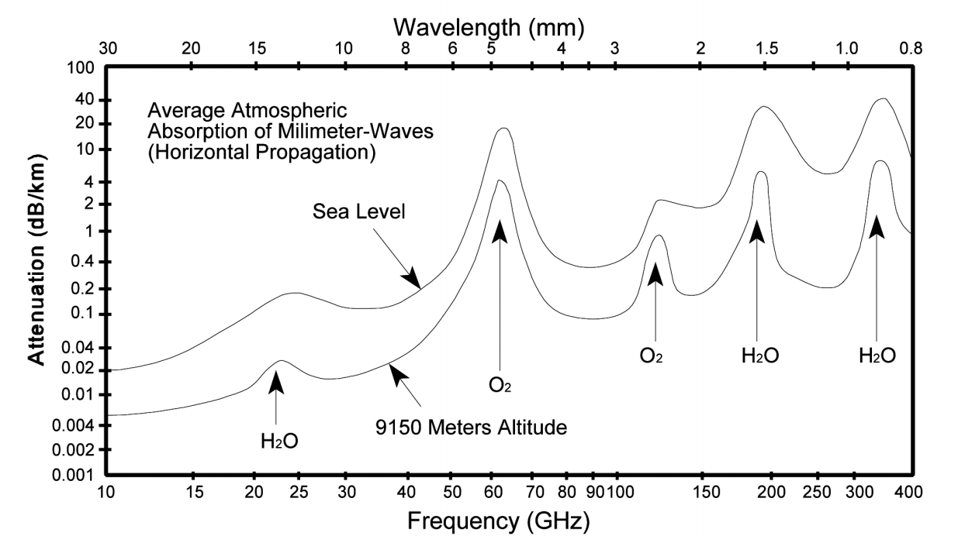
Oxygen absorption model
At 60 GHz, Oxygen molecules in the atmosphere interact with the RF signals to cause significant attenuation. Due to this attenuation the 60 GHz band is not a good frequency to use for long-range radar or communication applications. At 60 GHz O2 can cause an attenuation of up to 10 dB/km.
the 60 GHz band can still be used for short-range communications, such as local wireless area networks. The 60 GHz band can also be used for communication between satellites (called cross-linking) in the high earth orbit. Since there is almost no oxygen in space at the geosynchronous altitudes of 43,000 km or 26,000 miles, attenuation at this frequency is minimal.

Slide 6
Q-D approaches
3 types of rays, contributed by scenario-important macro objects, random objects, special non-stationary objects

Slide 9
Summary of Rays in Q-D model
Table
 |  | Quasi-Deterministic model
Types of Rays |  | Deterministic ray (D-Ray) |  |  | Random Ray (R-ray) |  | Flash Ray (F-ray)
Significance in Power |  | Major contribution into the signal power |  |  | Relatively weak
Occurance in Time |  | Presents all the time (unless blocked) |  |  |  |  | Appear for the short period of time
Origin from Object |  | Static surfaces reflections |  |  |  |  | Movieing objects
 |  | Scenario-important macro objects |  |  | Random Objects
 |  | Direct Ray (LoS) | Ground Reflected Ray | Additional D-Rays | Statistical R-Rays | Random Objects Reflections R-Ray | Moving cars, buses and other dynamic objects
 |  |  |  | Walls, ceiling, table | Arrival according to Poisson process | Randomly placed spherical objects
Delay |  | Geometric |  |  | Random | Geometric | Geometric
Angle
Scenarios | Open Area Outdoor Hotspot Access | • | • |  | •
 | Outdoor Street Canyon Hotspot Access | • | • | • | • | • | •
 | Large Hotel Lobby | • | • | • | •

Slide 10
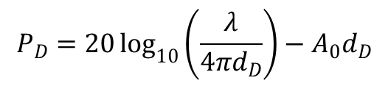
D-Rays Modeling
Delay and Angles
Geometry and propagation conditions
Propagation loss
Calculated by Friis equation, with taking into account additional losses from the oxygen absorption
E.g. LoS ray power:
$$P_{D}=20\log_{10}\left(\frac{λ}{4πd_{D}}\right)−A_{0}d_{D}$$

Slide 11

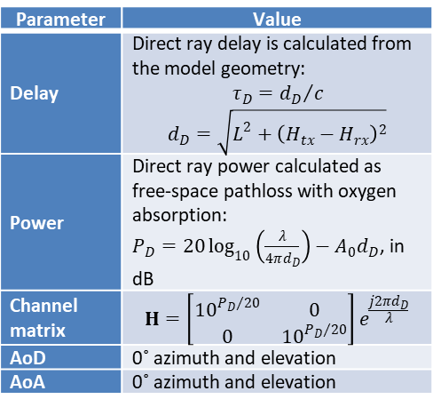


Direct D-Ray
Direct LOS ray is a ray between TX and RX
Strongest Power, lowest delay
Parameter | Value
Delay | Direct ray delay is calculated from the model geometry: $$τ_{D}={d_{D}}/c$$ $$d_{D}=\sqrt{L^{2}+{\left(H_{tx}−H_{rx}\right)}^{2}}$$
Power | Direct ray power calculated as free-space pathloss with oxygen absorption: $P_{D}=20\log_{10}\left(\frac{λ}{4πd_{D}}\right)−A_{0}d_{D}$, in dB
Channel matrix | $$H=\left[\begin{matrix}{10}^{{P_{D}}/{20}} & 0 \\ 0 & {10}^{{P_{D}}/{20}}\end{matrix}\right]e^{\frac{j2πd_{D}}{λ}}$$
AoD | 0˚ azimuth and elevation
AoA | 0˚ azimuth and elevation
$$H_{tx}$$
$$H_{rx}$$
$$L$$

Slide 12

Ground reflected D-ray
Parameter | Value
Delay | Ground-reflected ray delay is calculated from the model geometry: $$τ_{G}={d_{G}}/c$$ $$d_{G}=\sqrt{L^{2}+{\left(H_{tx}+H_{rx}\right)}^{2}}$$
Power | Ground-reflected power calculated as free-space pathloss with oxygen absorption, with additional reflection loss calculated on the base of Fresnel equations. Reflection loss R is different for vertical and horizontal polarizations $$P_{⊥}=20\log_{10}\left(\frac{λ}{4πd_{G}}\right)−A_{0}d_{G}+R_{⊥}+F;$$ $$P_{∥}=20\log_{10}\left(\frac{λ}{4πd_{G}}\right)−A_{0}d_{G}+R_{∥}+F$$ $$F={80}/{\ln{10}}{\left({πσ_{h}\sin{φ}}/λ\right)}^{2}$$ $$R_{⊥}=20\log_{10}\left(\frac{\sin{φ}−\sqrt{B_{⊥}}}{\sin{φ}+\sqrt{B_{⊥}}}\right); R_{∥}=20\log_{10}\left(\frac{\sin{φ}−\sqrt{B_{∥}}}{\sin{φ}+\sqrt{B_{∥}}}\right)$$ $B_{∥}=ε_{r}−\cos^{2}{φ}$ for horizontal polarization. $B_{⊥}=\left(ε_{r}−\cos^{2}{φ}\right)/ε_{r}^{2}$ for vertical polarization, where $\tan{φ}=\frac{H_{tx}+H_{rx}}{L}$ and $σ_{h}$is a surface roughness
Channel matrix | $$H=\left[\begin{matrix}{10}^{{P_{⊥}}/{20}} & ξ \\ ξ & {10}^{{P_{∥}}/{20}}\end{matrix}\right]e^{\frac{j2πd_{G}}{λ}}$$
AoD | Azimuth: 0˚, Elevation: $θ_{AoD}=\tan^{−1}\left(\frac{L}{H_{tx}−H_{rx}}\right)−\tan^{−1}\left(\frac{L}{H_{tx}+H_{rx}}\right)$
AoA | Azimuth: 0˚, Elevation:$θ_{AoA}=\tan^{−1}\left(\frac{H_{tx}+H_{rx}}{L}\right)−\tan^{−1}\left(\frac{H_{tx}−H_{rx}}{L}\right)$
$$H_{tx}$$
$$H_{rx}$$
$$L$$

